Slide 1
What’s new in Jmol for Proteopedia
Bob Hanson
Proteopedia 10th Anniversary Conference
U Mass Amherst
Jan 22, 2018

Slide 2
Relatively new/underutilized features:
Structure Validation
Straightness
LOAD /val
More Annotations:
LOAD /DOM -- domains
LOAD /DSSR -- nucleic acid secondary structure
Surfaces
Surface slabbing
Contact
Writing files
write “xxx.PNG” as PNGJ
write ISOSURFACE xxxx. JVXL – fast delivery and construction of surfaces
write “cache://…”
write SCENE
Misc
PyMOL session file (.pse) reader
Coarse-graining

Slide 3
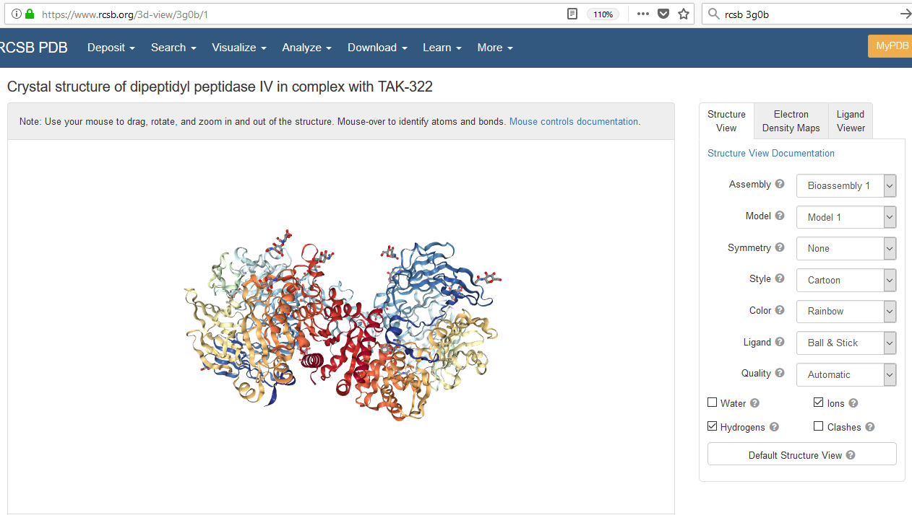

Slide 4
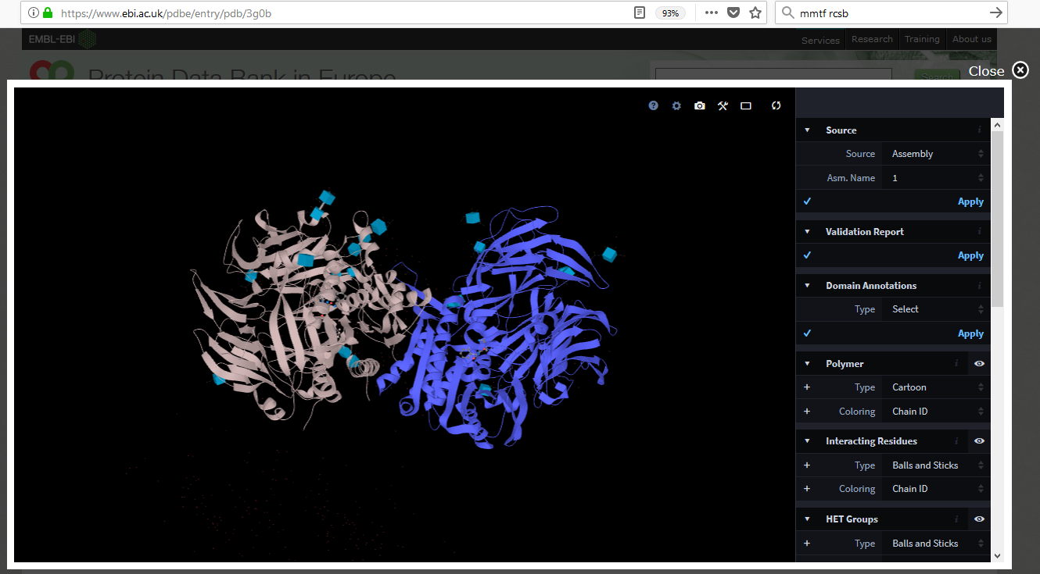

Slide 5
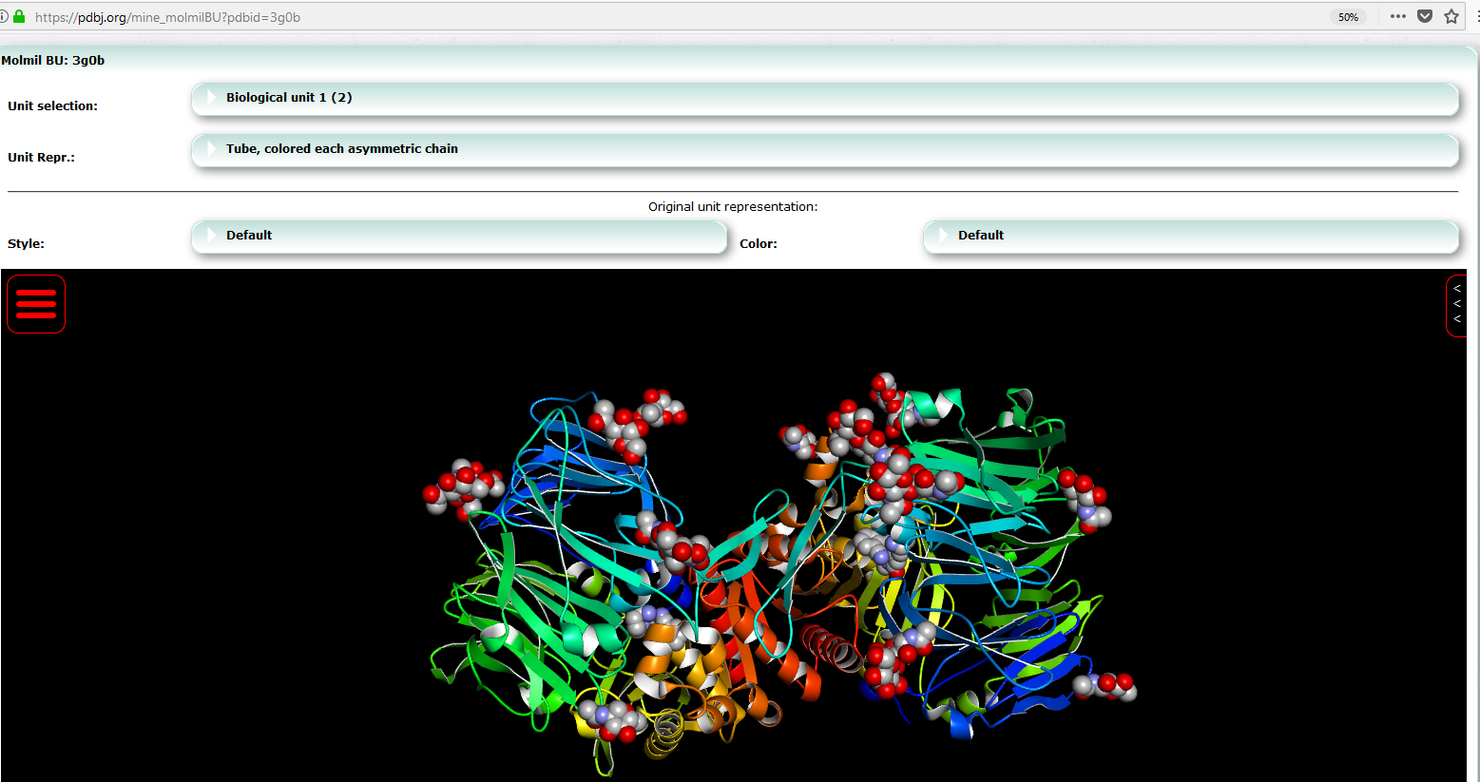

Slide 6
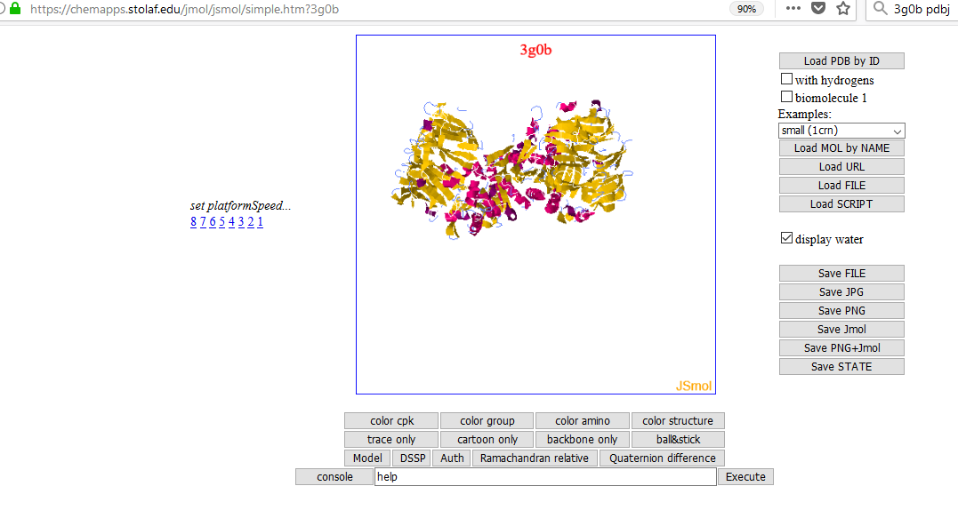

Slide 7
But before that, a word about file size...
3g0b (1.2 MB) Uncompressed/Delivered (MB)
Page +Viewer = Total
NGL (RCSB) 1.66/1.02 +3.60/0.80 = 5.26/1.82 (mmtf 0.19)
LiteMol (PDBe) 3.25/1.09 +2.08/0.58 = 5.33/1.67 (bcif 0.10)
Molmil (PDBj) 1.41/0.66 +3.73/0.65 = 5.14/1.31 (mmjson 0.37)
JSmol (Proteopedia) - - 5.13/2.32 (pdb.gz 1.20)
JSmol (St. Olaf) 1.93/0.58 +0.82/0.35 = 2.75/0.93 (mmtf 0.19)

Slide 8
But before that, a word about file size...
3g0b (1.2 MB) Uncompressed/Delivered (MB)
Page +Viewer = Total
NGL (RCSB) 1.66/1.02 +3.60/0.80 = 5.26/1.82 (mmtf 0.19)
LiteMol (PDBe) 3.25/1.09 +2.08/0.58 = 5.33/1.67 (bcif 0.10)
Molmil (PDBj) 1.41/0.66 +3.73/0.65 = 5.14/1.31 (mmjson 0.37)
JSmol (Proteopedia) - - 5.13/2.32 (pdb.gz 1.20)
JSmol (St. Olaf) 1.93/0.58 +0.82/0.35 = 2.75/0.93 (mmtf 0.19)

Slide 9
But before that, a word about file size...
3g0b (1.2 MB) Uncompressed/Delivered (MB)
Page +Viewer = Total
NGL (RCSB) 1.66/1.02 +3.60/0.80 = 5.26/1.82 (mmtf 0.19)
LiteMol (EBI) 3.25/1.09 +2.08/0.58 = 5.33/1.67 (bcif 0.10)
Molmil (PDBj) 1.41/0.66 +3.73/0.65 = 5.14/1.31 (mmjson 0.37)
JSmol (Proteopedia) - - 5.13/2.32 (pdb.gz 1.20)
JSmol (St. Olaf) 1.93/0.58 +0.82/0.35 = 2.75/0.93 (mmtf 0.19)

Slide 10
But before that, a word about file size...
corejmol 0.36
corescript 0.12
JSmol.min.js 0.07
corebio 0.05 total JSmol delivered = 0.68 MB (includes jQuery)
coresym 0.04
misc 0.04
JSmol (St. Olaf) 1.93/0.58 +0.82/0.35 = 2.75/0.93 (mmtf 0.19)

Slide 11
Relatively new/underutilized features:
Structure Validation
Straightness
LOAD /val
More Annotations:
LOAD /DOM -- domains
LOAD /DSSR -- nucleic acid secondary structure
Surfaces
Surface slabbing
Contact
Writing files
write “xxx.PNG” as PNGJ
write ISOSURFACE xxxx. JVXL – fast delivery and construction of surfaces
write “cache://…”
write SCENE
Misc
PyMOL session file (.pse) reader
Coarse-graining

Slide 12
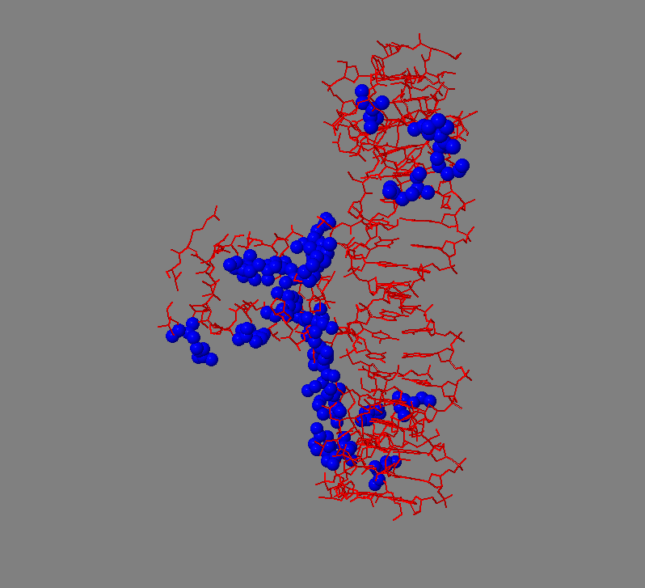
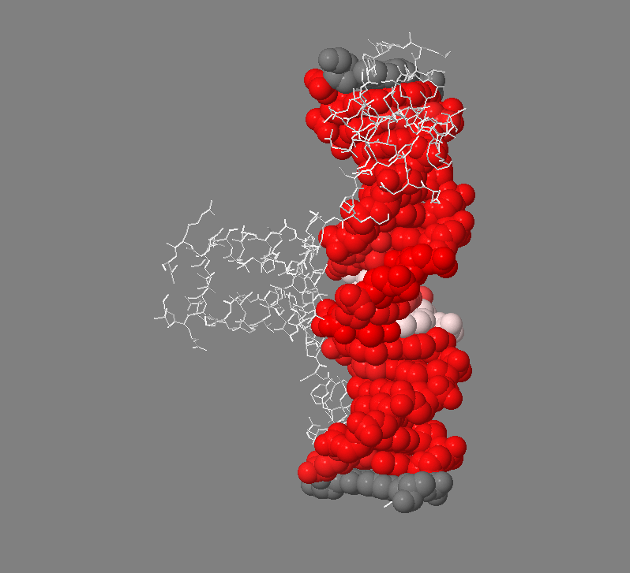
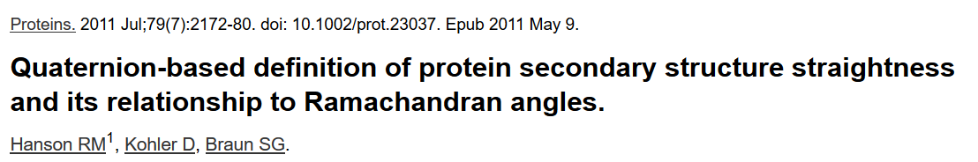

Straightness (1d66)
Straightness is defined in Jmol as the (four-dimensional) dot product of the quaternion frame associated with two adjacent groups.

Slide 13
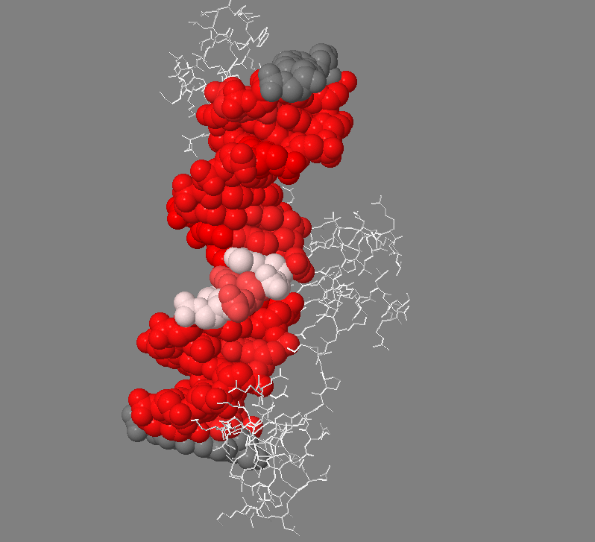
Straightness (1d66)
Straightness is defined in Jmol as the (four-dimensional) dot product of the quaternion frame associated with two adjacent groups.

Slide 14
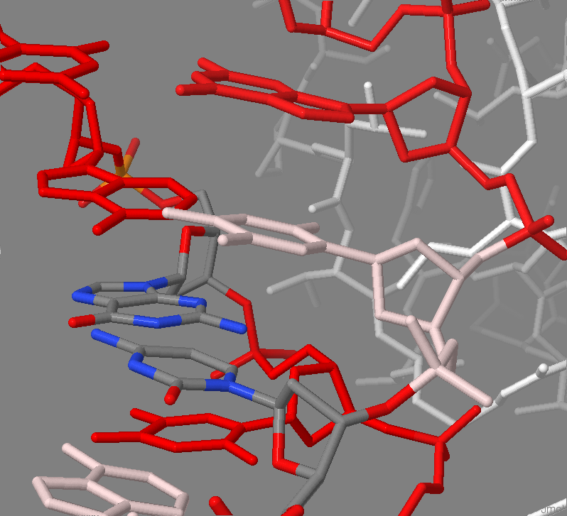
Straightness (1d66)
Straightness is defined in Jmol as the (four-dimensional) dot product of the quaternion frame associated with two adjacent groups.

Slide 15
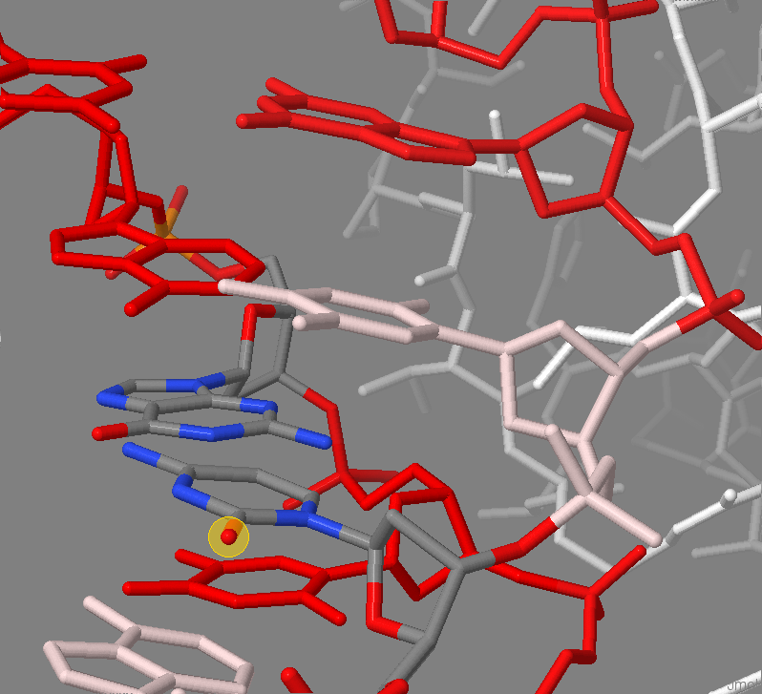
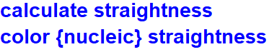
Straightness (1d66)
Straightness is defined in Jmol as the (four-dimensional) dot product of the quaternion frame associated with two adjacent groups.

Slide 16
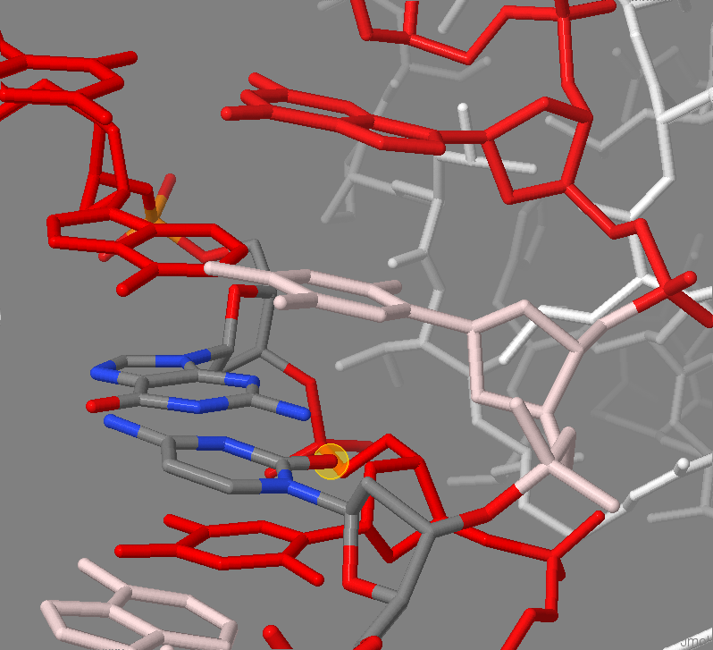

Straightness (1d66)
Straightness is defined in Jmol as the (four-dimensional) dot product of the quaternion frame associated with two adjacent groups.

Slide 17
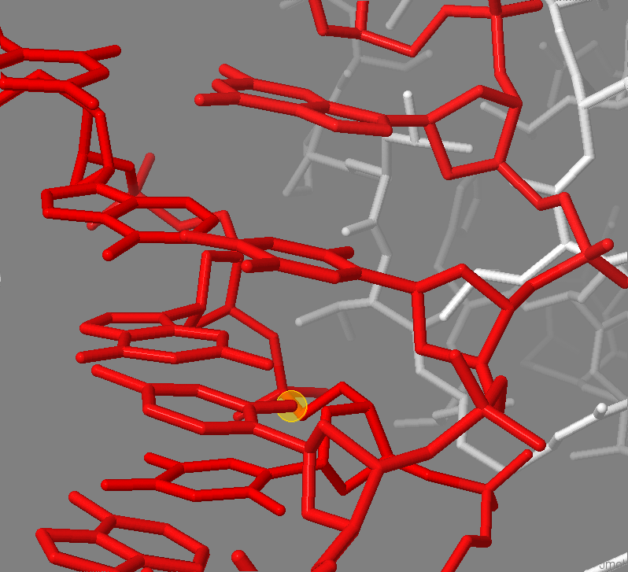
Straightness (1d66)
Straightness is defined in Jmol as the (four-dimensional) dot product of the quaternion frame associated with two adjacent groups.

Slide 18
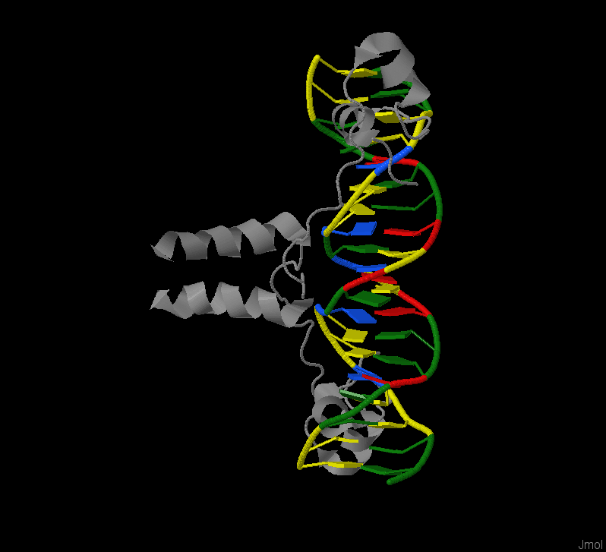
Annotations – structure validation
For several years it has been very easy to retrieve structures from RCSB ( load =4TVJ ) or from PDBe ( load *4TVJ ) into Jmol. What is new is the capability to add to that structural data the entire set of validation data present in the validation report.
This is accomplished by appending to the Jmol load request the suffix /val: load =4TVJ/val; load *4TVJ/val.
The /val suffix instructs Jmol to make an associated call to PDBe’s RESTful API in order to retrieve a structured JSON list of validation data that then becomes part of the overall Jmol data structure associated with this model.

Slide 19
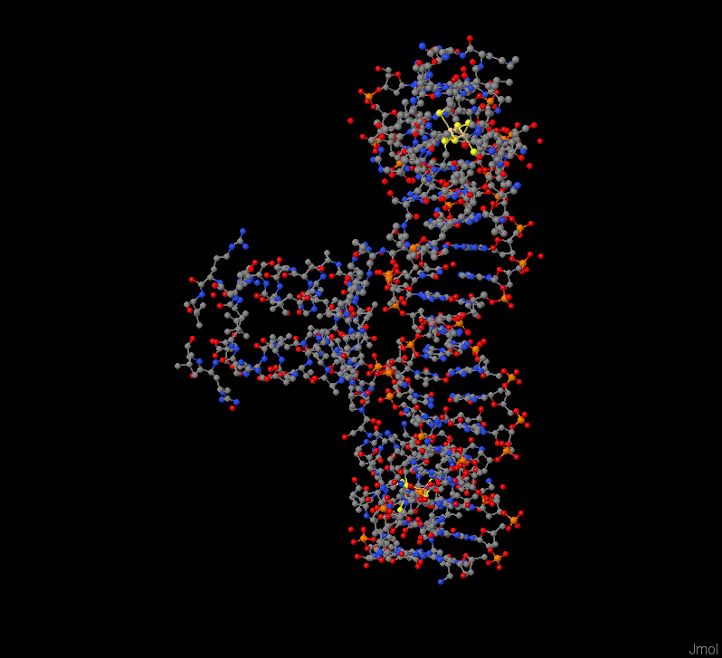
Annotations – structure validation
For several years it has been very easy to retrieve structures from RCSB ( load =4TVJ ) or from PDBe ( load *4TVJ ) into Jmol. What is new is the capability to add to that structural data the entire set of validation data present in the validation report.
This is accomplished by appending to the Jmol load request the suffix /val: load =4TVJ/val; load *4TVJ/val.
The /val suffix instructs Jmol to make an associated call to PDBe’s RESTful API in order to retrieve a structured JSON list of validation data that then becomes part of the overall Jmol data structure associated with this model.

Slide 20
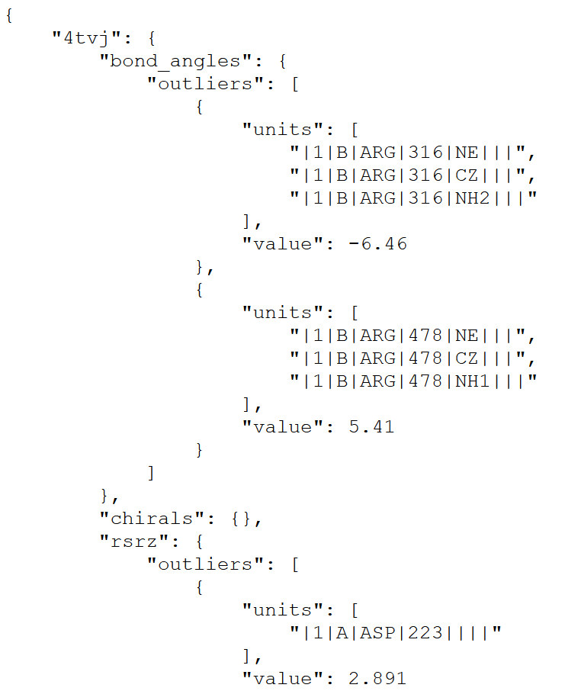
Annotations – structure validation
For several years it has been very easy to retrieve structures from RCSB ( load =4TVJ ) or from PDBe ( load *4TVJ ) into Jmol. What is new is the capability to add to that structural data the entire set of validation data present in the validation report.
This is accomplished by appending to the Jmol load request the suffix /val: load =4TVJ/val; load *4TVJ/val.
The /val suffix instructs Jmol to make an associated call to PDBe’s RESTful API in order to retrieve a structured JSON list of validation data that then becomes part of the overall Jmol data structure associated with this model.

Slide 21
Annotations – structure validation
For several years it has been very easy to retrieve structures from RCSB ( load =4TVJ ) or from PDBe ( load *4TVJ ) into Jmol. What is new is the capability to add to that structural data the entire set of validation data present in the validation report.
This is accomplished by appending to the Jmol load request the suffix /val: load =4TVJ/val; load *4TVJ/val.
The /val suffix instructs Jmol to make an associated call to PDBe’s RESTful API in order to retrieve a structured JSON list of validation data that then becomes part of the overall Jmol data structure associated with this model.
https://www.bgsu.edu/research/rna/help/rna-3d-hub-help/unit-ids.html

Slide 22
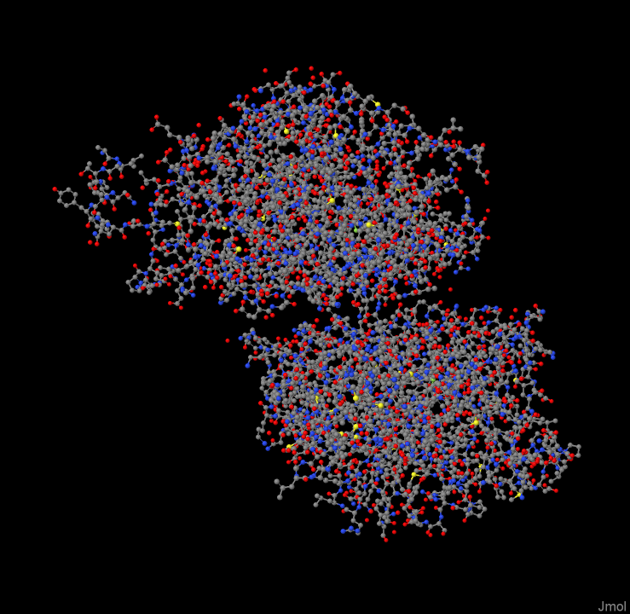
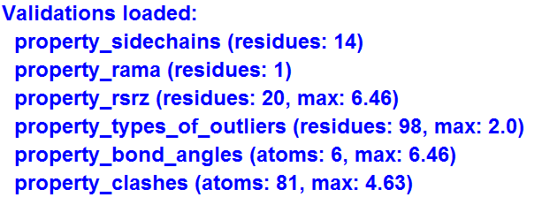
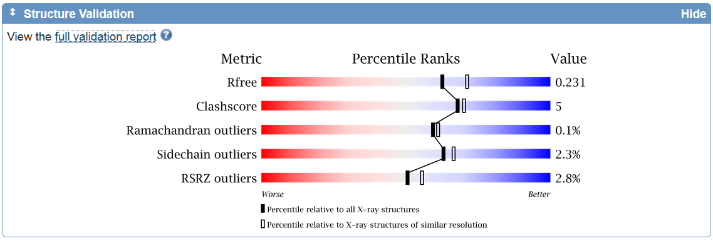
Annotations
Visualizing validation data
load =4tvj/val

Slide 23
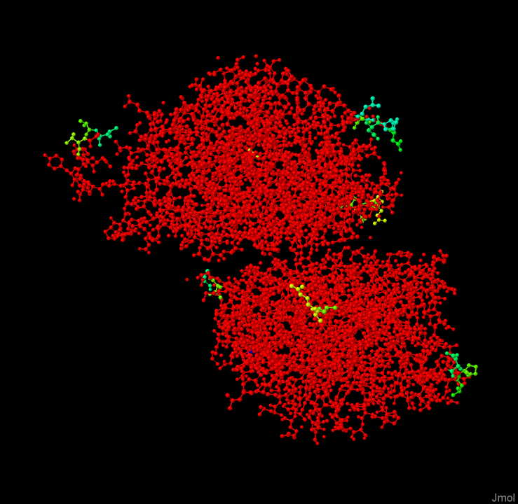
Annotations
Visualizing validation data
load =4tvj/val
color property_rsrz

Slide 24
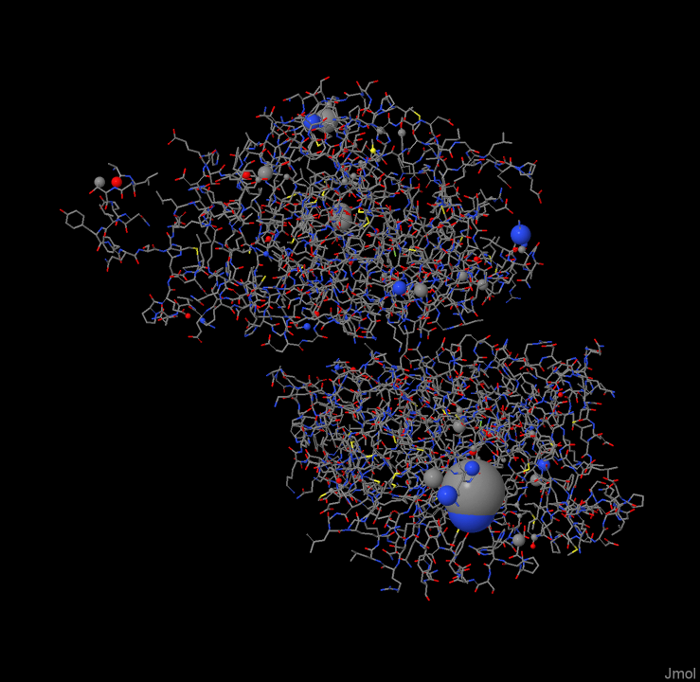
Annotations
Visualizing validation data
load =4tvj/val
{*}.radius = {*}.property_clashes.all

Slide 25
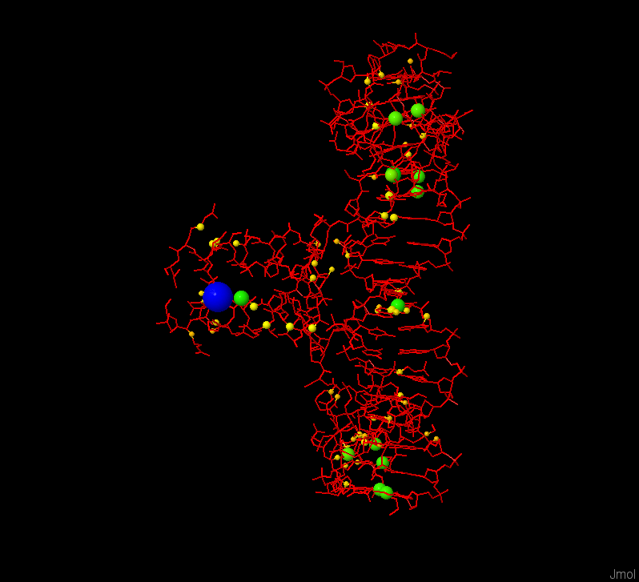
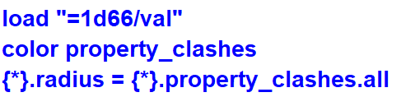
Structure Validation load =1d66/val
For several years it has been very easy to retrieve structures from RCSB ( load =4TVJ ) or from PDBe ( load *4TVJ ) into Jmol. What is new is the capability to add to that structural data the entire set of validation data present in the validation report.
This is accomplished by appending to the Jmol load request the suffix /val: load =4TVJ/val; load *4TVJ/val.

Slide 26
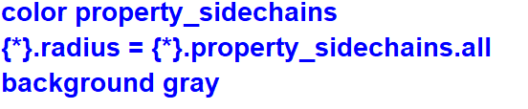
Structure Validation load =1d66/val
For several years it has been very easy to retrieve structures from RCSB ( load =4TVJ ) or from PDBe ( load *4TVJ ) into Jmol. What is new is the capability to add to that structural data the entire set of validation data present in the validation report.
This is accomplished by appending to the Jmol load request the suffix /val: load =4TVJ/val; load *4TVJ/val.

Slide 27
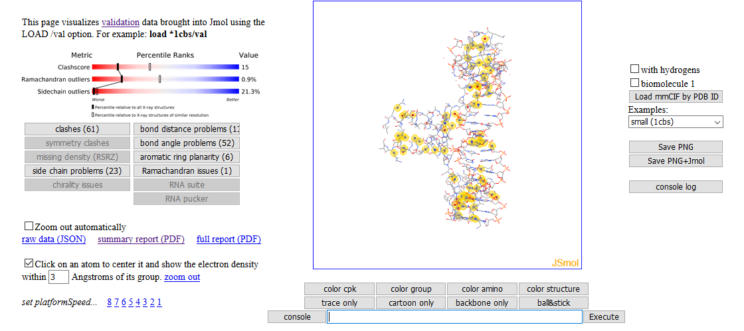
Structure Validation load =1d66/val
https://chemapps.stolaf.edu/jmol/jsmol/validation.htm

Slide 28
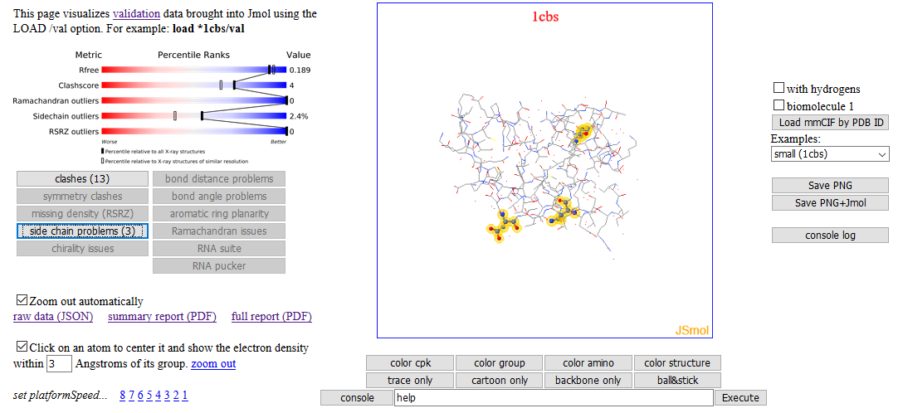
Structure Validation load =1d66/val
https://chemapps.stolaf.edu/jmol/jsmol/validation.htm

Slide 29
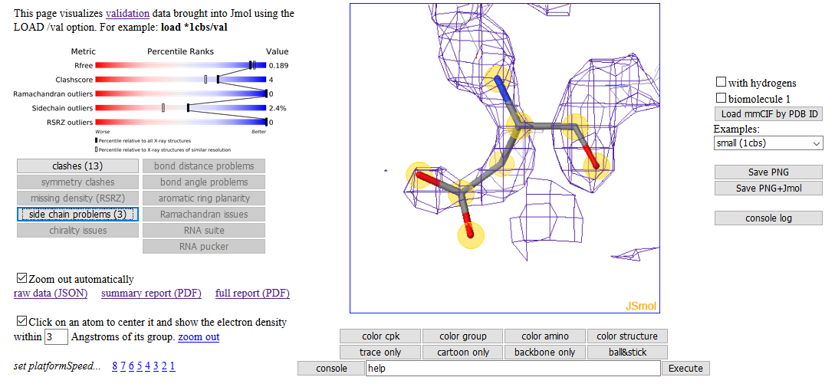
Structure Validation load =1d66/val
https://chemapps.stolaf.edu/jmol/jsmol/validation.htm

Slide 30
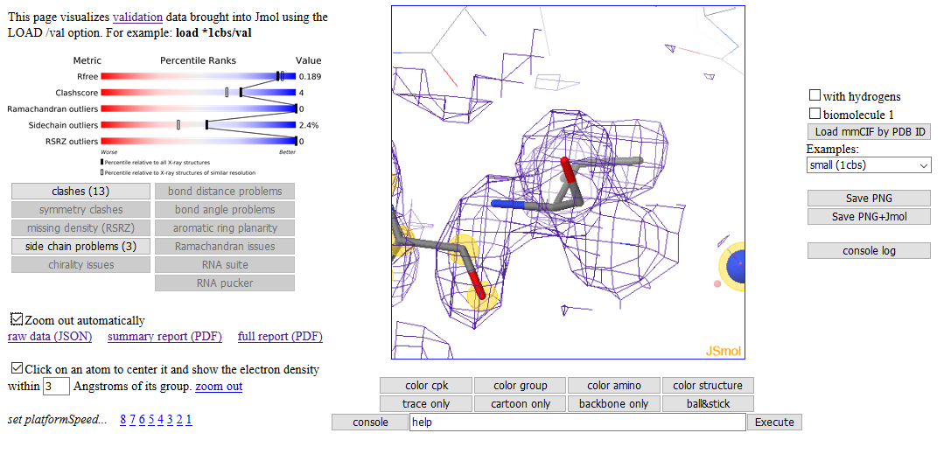
Structure Validation load =1d66/val
https://chemapps.stolaf.edu/jmol/jsmol/validation.htm

Slide 31
Structure Validation load =1d66/val
Uses the new “binary cif” format for delivering subsets of electron density developed at EBI:
https://www.ebi.ac.uk/pdbe/densities/x-ray/1cbs/box/9.836,9.418,11.005/19.338,16.811,21.408?space=cartesian&encoding=bcif
https://chemapps.stolaf.edu/jmol/jsmol/validation.htm

Slide 32
Relatively new/underutilized features:
Structure Validation
Straightness
LOAD /val
More Annotations:
LOAD /DOM -- domains
LOAD /DSSR -- nucleic acid secondary structure
Surfaces
Surface slabbing
Contact
Writing files
write “xxx.PNG” as PNGJ
write ISOSURFACE xxxx. JVXL – fast delivery and construction of surfaces
write “cache://…”
write SCENE
Misc
PyMOL session file (.pse) reader
Coarse-graining

Slide 33
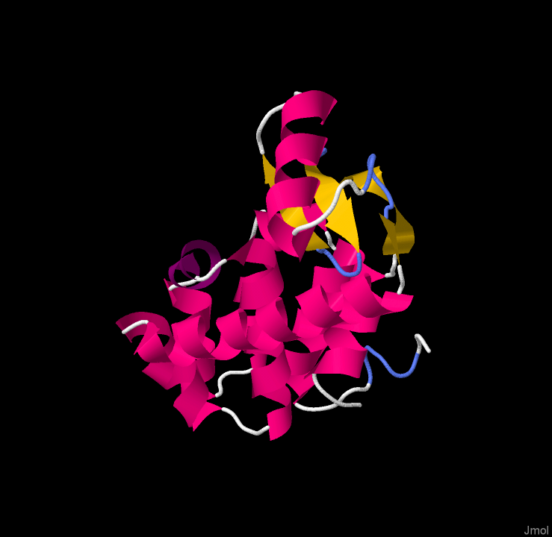
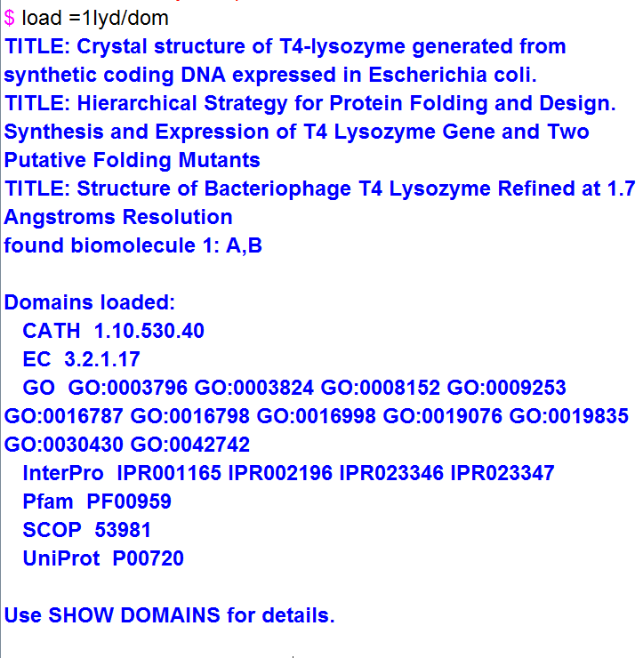
Annotations - Domains
=xxxx/dom or *xxxx/dom

Slide 34
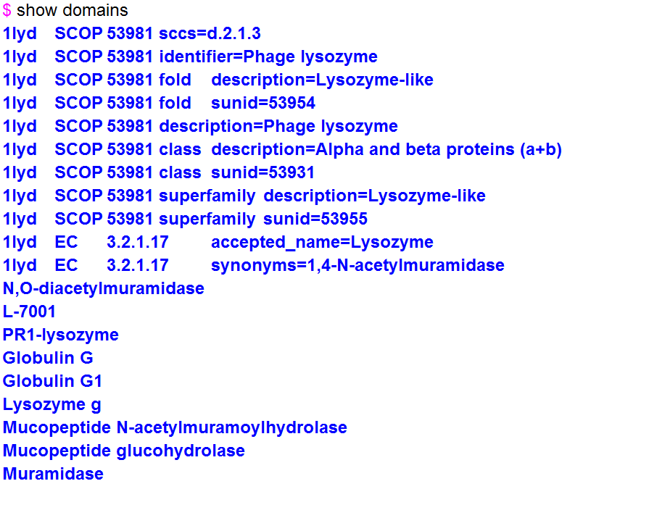
Annotations - Domains
=xxxx/dom or *xxxx/dom

Slide 35
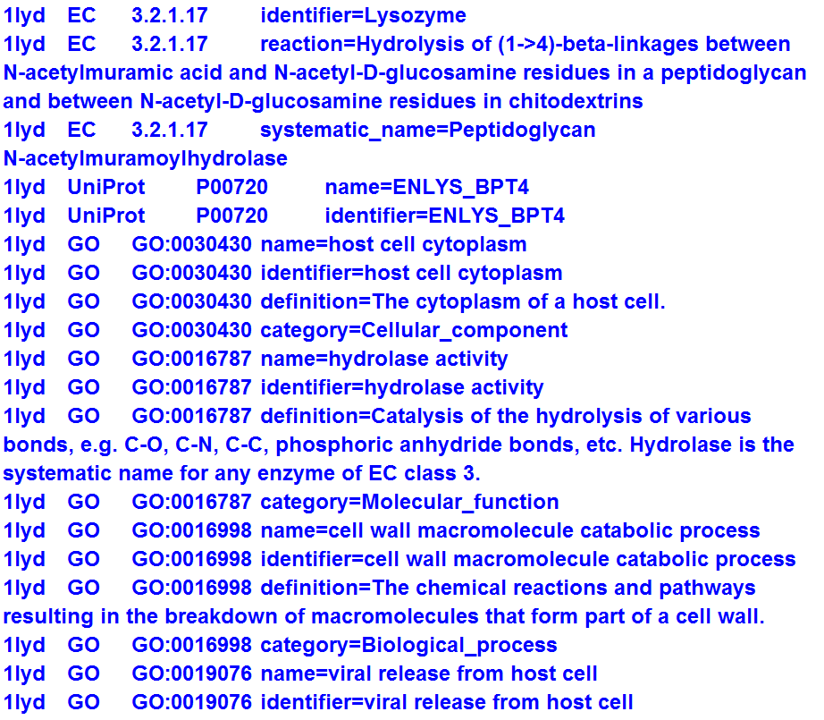
Annotations - Domains
=xxxx/dom or *xxxx/dom

Slide 36
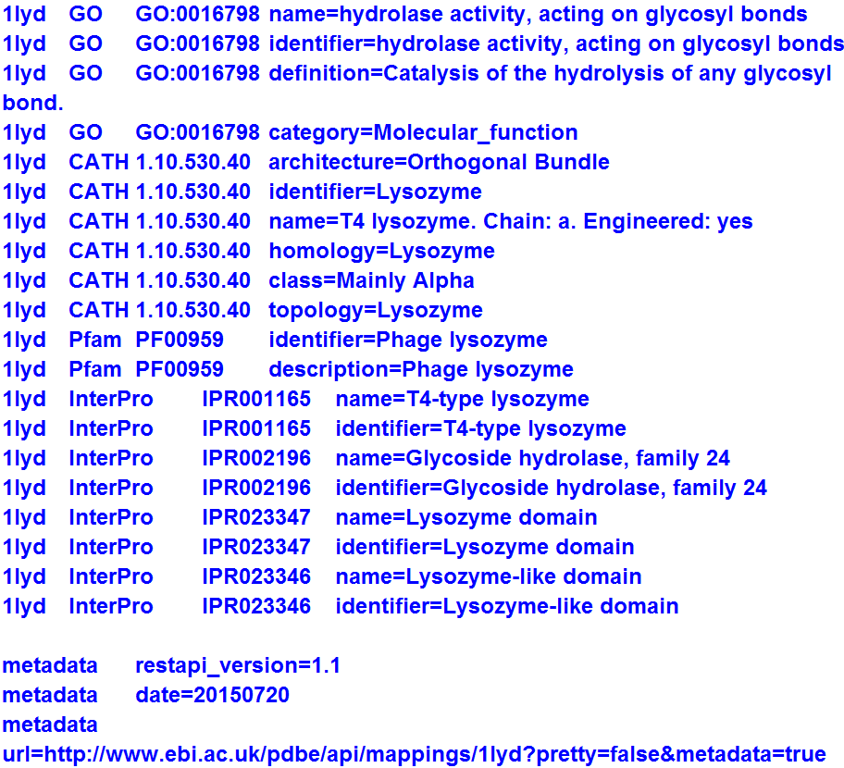

Annotations - Domains

Slide 37
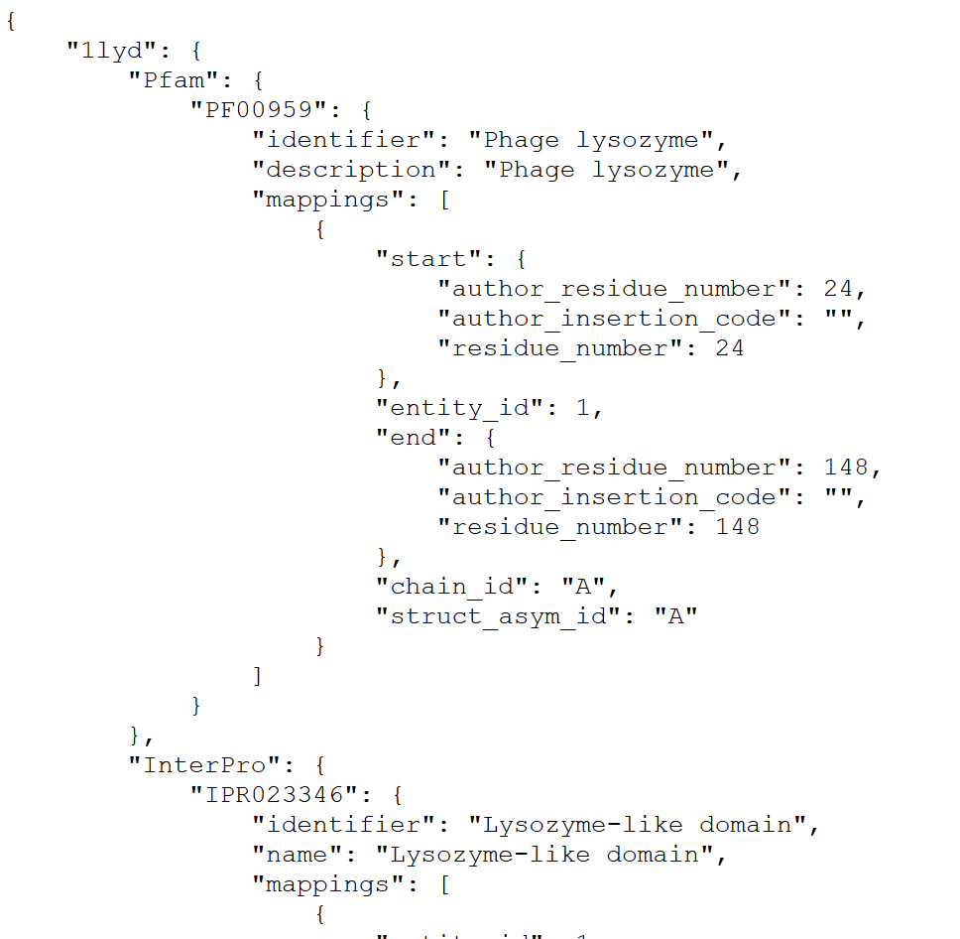
Annotations - Domains
http://www.ebi.ac.uk/pdbe/api/mappings/1lyd?pretty=true&metadata=true

Slide 38
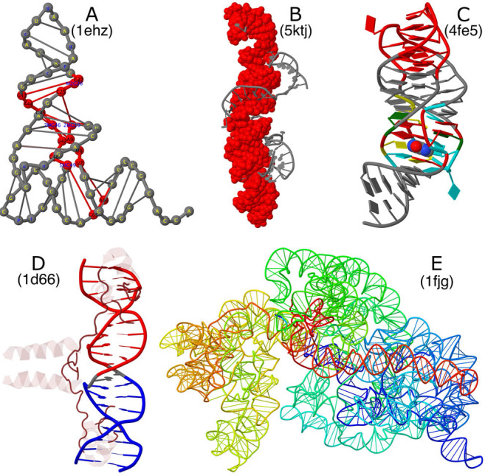
Annotations – RNA/DNA secondary structure
Nucleic Acids Res. 2017 May 3. doi: 10.1093/nar/gkx365.
DSSR-enhanced visualization of nucleic acid structures in Jmol.
Hanson RM, Lu XJ
Google: hanson dssr

Slide 39
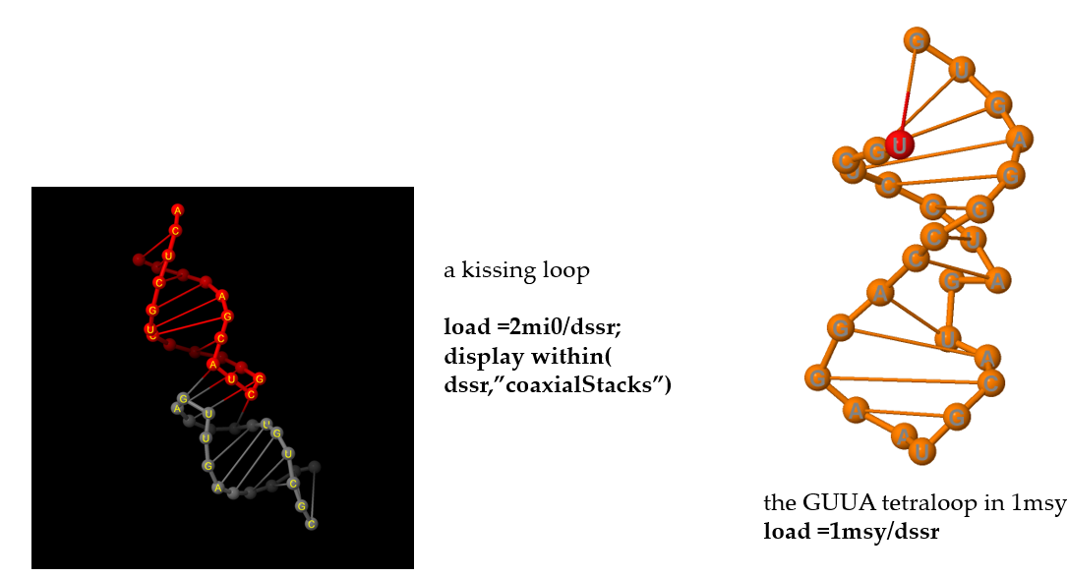
Annotations – RNA/DNA secondary structure
load =xxxx/dssr or load *xxxx/dssr
A kissing loop
load =2mi0/dssr

Slide 40
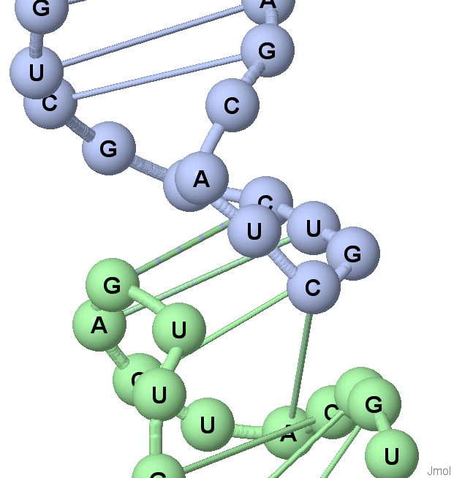
aside… cool RNA rendering
load =2mi0/dssr
color chain
cartoons only
set cartoonSteps
select _P
spacefill 2.0
set fontScaling true
label "%n"
set labeloffset 0 0
font labels 12 bold
color labels black

Slide 41
Annotations – RNA/DNA secondary structure
load =1msy/dssr
TITLE: Common and distinctive features of GNRA tetraloops based on a GUAA tetraloop structure at 1.4 A resolution
HOH = WATER
1MSY
found biomolecule 1: A,B
_M.dssr.counts = {helices=1, iloops=1, pairs=13, stacks=4, hairpins=1, nts=27, hbonds=40, stems=1, isoCanonPairs=1, multiplets=1}
_M.dssr.dbn = {m1_chain_A={num_nts=27, num_chars=27, sstr=((((((.....(....)....)))))), bseq=UGCUCCUAGUACGUAAGGACCGGAGUG, form=.AAAA....A.A.........AAAA.-}, all_chains={num_nts=27, num_chars=27, sstr=((((((.....(....)....)))))), bseq=UGCUCCUAGUACGUAAGGACCGGAGUG, form=.AAAA....A.A.........AAAA.-}}

Slide 42
Annotations – RNA/DNA secondary structure
Additional annotations load =1msy/dssr
Print _M.dssr.keys
atom2bases
chains
counts
ct
dbn
hairpins
hbonds
helices
iloops
isoCanonPairs
metadata
multiplets
nts
num_atom2bases
num_hairpins
num_hbonds
num_helices
num_iloops
num_isoCanonPairs
num_multiplets
num_nts
num_pairs
num_splayUnits
num_stacks
num_stems
pairs
paths
refCoords
splayUnits
stacks
stems

Slide 43
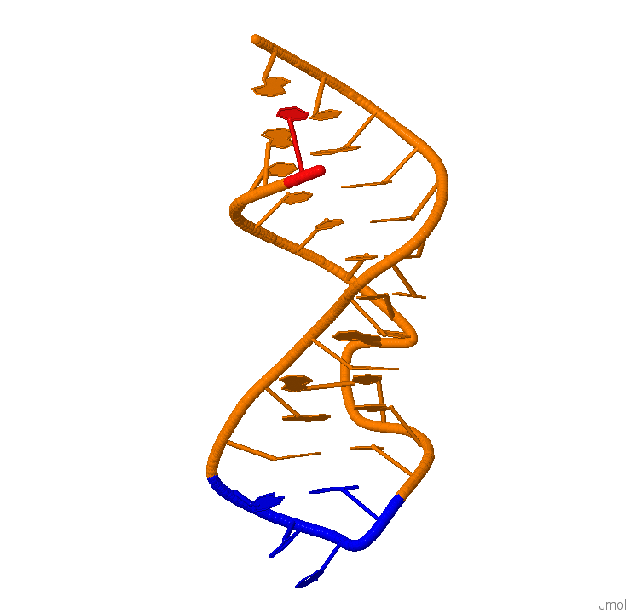
Annotations – RNA/DNA secondary structure
load =1msy/dssr
color {hairpins} blue
print _M.dssr.hairpins.count
1
print _M.dssr.hairpins[1].keys
bridges
bridging_nts
index
nts_long
nts_short
num_nts
num_stems
stem_indices
summary
type

Slide 44
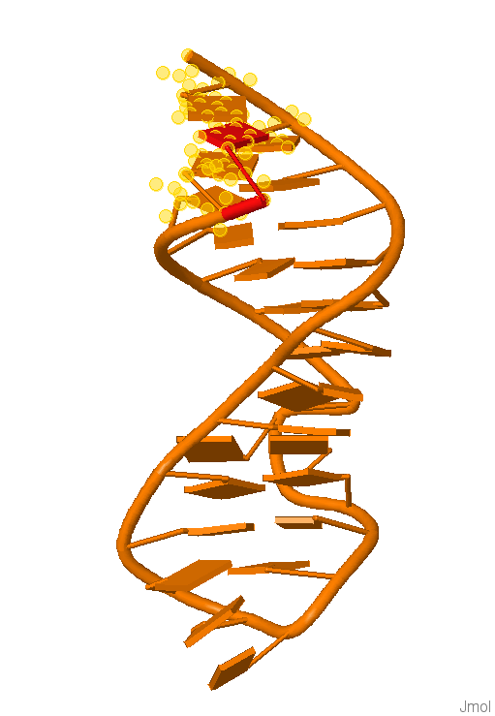
Annotations – RNA/DNA secondary structure
load =1msy/dssr
cartoons only;set cartoonblocks
print _M.dssr.pairs.count
13
print _M.dssr.pairs[1]
{
"DSSR" : "cW-W"
"LW" : "cWW"
"Saenger" : "28-XXVIII"
"bp" : "U-G"
"index" : 1
"name" : "Wobble"
"nt1" : "|1|A|U|2647||||"
"nt2" : "|1|A|G|2673||||"
}
select on
within(dssr,"pairs[where bp='U-G' or bp=‘G-U’ ]”)

Slide 45
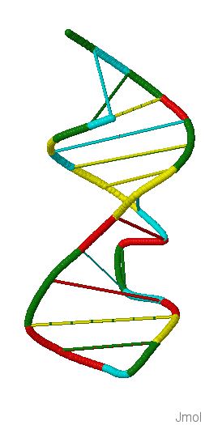
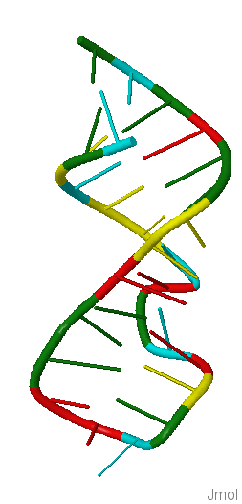
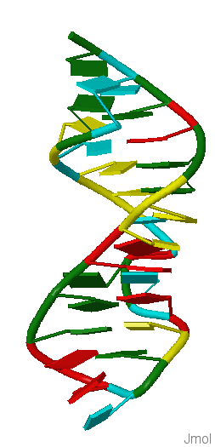
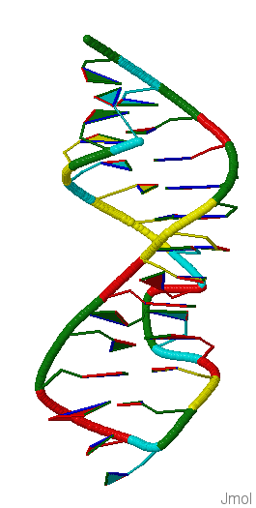
New nucleic acid rendering options
set cartoonSteps set cartoonLadders set cartoonBlocks set cartoonBaseEdges

Slide 46
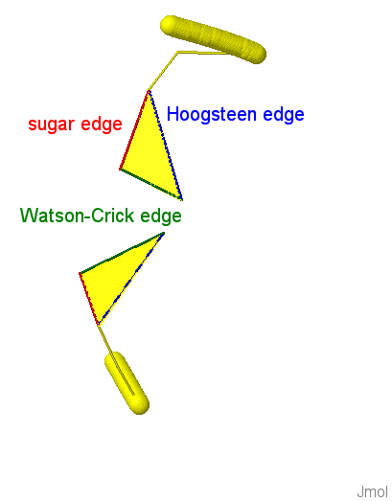
New nucleic acid rendering options
set cartoonBaseEdges

Slide 47
aside… set labelFor, color in labels, and set picking labels
set cartoonBaseEdges
btw:
display 2647 or 2673
select *; color yellow; font labels 20
set labelfor @560 "<color=red>sugar edge</color>"
set labelfor @561 "<color=blue>Hoogsteen edge</color>"
set labelfor @562 "<color=green>Watson-Crick edge</color>"
set picking labels
# shift-left-drag labels to new positions
set picking identify

Slide 48
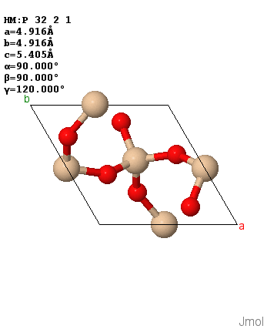
side note – Jmol and JSON
Jmol now reads JSON data natively:
x = load(“quartz.json”, “JSON”)
print x.models[1].select("_cell*")
{
"_cell_angle_alpha" : "90"
"_cell_angle_beta" : "90"
"_cell_angle_gamma" : "120"
"_cell_length_a" : "4.916"
"_cell_length_b" : "4.916"
"_cell_length_c" : "5.4054"
"_cell_volume" : "113.131“
}

Slide 49
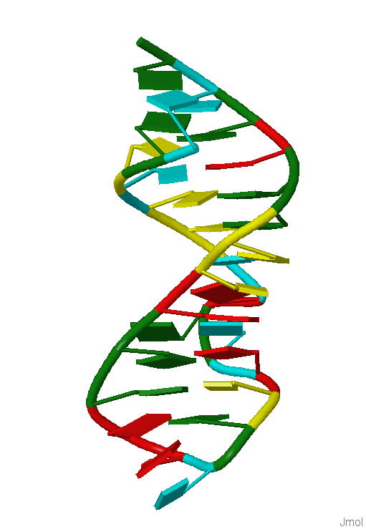
Annotations -- Summary
We now have ready access to a wide variety of metadata relating to biomolecules.
Jmol is at the forefront of integration of these services into molecular visualization.
You can think of a model with annotations as a mini “database” that can be queried. JmolSQL is very powerful.

Slide 50
Relatively new/underutilized features:
Structure Validation
Straightness
LOAD /val
More Annotations:
LOAD /DOM -- domains
LOAD /DSSR -- nucleic acid secondary structure
Surfaces
Surface slabbing
Contact
Writing files
write “xxx.PNG” as PNGJ
write ISOSURFACE xxxx. JVXL – fast delivery and construction of surfaces
write “cache://…”
write SCENE
Misc
PyMOL session file (.pse) reader
Coarse-graining

Slide 51
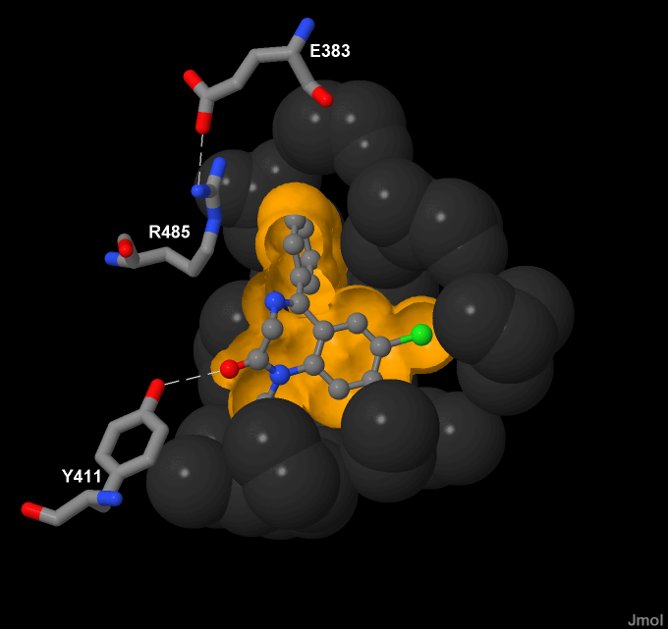
Example: Dynamically Clipped Surfaces
isosurface slab 50
isosurface slab none

Slide 52
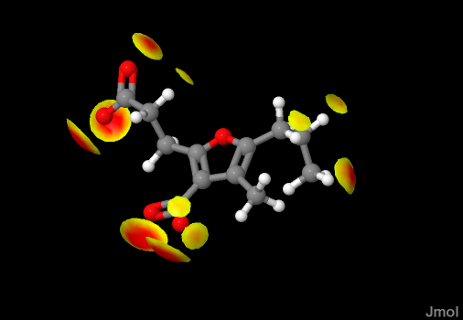
Contact Mapping
contact {ligand} TRIM

Slide 53
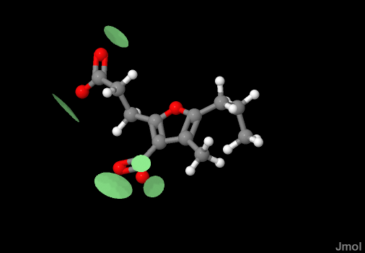
Contact Mapping
contact {ligand} HBOND

Slide 54
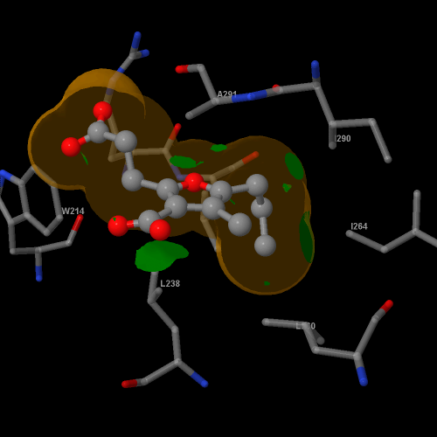
Contact Mapping

Slide 55

Contact Mapping

Slide 56

Contact Mapping

Slide 57

Contact Mapping

Slide 58


Contact Mapping

Slide 59

Contact Mapping

Slide 60


Contact Mapping
contact … CONNECT

Slide 61

Bigger challenges…
Discussing electron density
Show actual crystallographic electron density data, and allow for dynamic clipping based on sigma values.

Slide 62

Bigger challenges…
Discussing electron density
Show actual crystallographic electron density data, and allow for dynamic clipping based on sigma values.

Slide 63

Bigger challenges…
Discussing electron density
Show actual crystallographic electron density data, and allow for dynamic clipping based on sigma values.

Slide 64

Bigger challenges…
Discussing electron density
Show actual crystallographic electron density data, and allow for dynamic clipping based on sigma values.

Slide 65
Relatively new/underutilized features:
Structure Validation
Straightness
LOAD /val
More Annotations:
LOAD /DOM -- domains
LOAD /DSSR -- nucleic acid secondary structure
Surfaces
Surface slabbing
Contact
Writing files
write “xxx.PNG” as PNGJ
write ISOSURFACE xxxx. JVXL – fast delivery and construction of surfaces
write “cache://…”
write SCENE
Misc
PyMOL session file (.pse) reader
Coarse-graining

Slide 66
Valuable WRITE options
WRITE “myfile.png” as PNGJ
Creates a file that consists of a PNG image with appended ZIP file data that includes all necessary files to create the model.
WRITE ISOSURFACE/CONTACT/MO “mysurface.JVXL”
Creates a highly compressed surface file containing a single isosurface.
Highly recommended for surface data when creating PNGJ files.
WRITE whatever “cache://mydata.whatever”
Saves whatever data in a memory cache.
Cleared when a new file is loaded (but can be saved in a variable using x = write(…).
Highly recommended for surface data when creating PNGJ files.

Slide 67
Valuable WRITE options
WRITE SCENE “somefile.spt”
Different from other WRITE commands, because the script (SPT) file must already exist. This file contains sequences of “scenes” separated by PAUSE commands:
… scene commands …
pause scene 1
… scene commands …
pause scene 2
… scene commands …
pause scene 3

Slide 68
WRITE SCENE
WRITE SCENE was designed specifically for Proteopedia, but was never put into service.
WRITE SCENE was designed to solve two issues:
the problem of nonlinear traversal of page links
the problem of unnecessary file loading.
WRITE SCENE represents a paradigm shift for page creation.
WRITE SCENE is based on the idea of story-boarding that can involve distributed tasks. Think movie, animation, Disney, DreamWorks.

Slide 69
WRITE SCENE
WRITE SCENE was designed specifically for Proteopedia, but was never put into service.
WRITE SCENE was designed to solve two issues:
the problem of nonlinear traversal of page links
the problem of unnecessary file loading.
WRITE SCENE represents a paradigm shift for page creation.
WRITE SCENE is based on the idea of story-boarding that can involve distributed tasks. Think movie, animation, Disney, DreamWorks.
For example:
TASK: List learning objectives.
TASAK: create a sequence of hand-drawn sketches with associated ideas.
Second, create the
Different from other WRITE commands, because the script (SPT) file must already exist. This file contains sequences of “scenes” separated by PAUSE commands:
… scene commands …
pause scene 1
… scene commands …
pause scene 2
… scene commands …
pause scene 3

Slide 70
WRITE SCENE
WRITE SCENE is based on the idea of story-boarding that can involve distributed tasks. Think movie, animation, Disney, DreamWorks. Think teamwork. Think discussion. Think assessible.
For example:
TASK: List learning objectives.
TASK: Group the objectives into common elements and sub-elements. These are your sections and paragraphs.
TASK: Order objective groups into a sequence. This is the your page.
TASK: Sketch out a graphic visualization of the illustrations that associate with each. These are your scenes.
TASK: Create/propose a special Jmol script that creates each scene. This script has the form:
… scene commands …
pause scene 1
… scene commands …
pause scene 2
… scene commands …
pause scene 3

Slide 71
WRITE SCENE
TASK: Create/propose a special Jmol script that creates each scene. This script has the form:
… scene commands …
pause scene 1
… scene commands …
pause scene 2
… scene commands …
pause scene 3

Slide 72
WRITE SCENE
TASK: Use the WRITE SCENE command to translate the sequence of scenes into a set of PNGJ files. There will be two PNGJ files per scene, each containing an image and script, but not all containing the data. Half are “scene_n.min.png” and half “scene_n.all.png”. These could be produced or packaged for upload as a ZIP directory.
The MIN files are what are loaded by the green link. The script in these files is the full script for the entire set, and it can determine where we are in the “story” and what to do:
Next in sequence: Just run the section of the script we have, because we are continuing from the previous link.
Skip in sequence: Run silently through the skipped “scene frames” that are being skipped, without pauses, then render this scene normally.
Different scene set, or going backward, “key frame” idea – load the “ALL” file for this scene.
Note that one does not work directly with these files. One simply edits the page/section/paragraph script when necessary have to worry about exactly what is in these files, and then recreates them.

Slide 73
WRITE SCENE
Basic workflow:
Create objectives, scenes, and page text.
Use Jmol to create a single ZIP file containing the scenes and master script.
Upload the ZIP file to Proteopedia.
Create the page, linking text to scenes. (Maybe part of 2 or 3?)
To edit, edit the master script and go back to Step 2.
Like I said, this proposal represents a significant paradigm shift – or at least a significantly new option for page creation.

Slide 74
Relatively new/underutilized features:
Structure Validation
Straightness
LOAD /val
More Annotations:
LOAD /DOM -- domains
LOAD /DSSR -- nucleic acid secondary structure
Surfaces
Surface slabbing
Contact
Writing files
write “xxx.PNG” as PNGJ
write ISOSURFACE xxxx. JVXL – fast delivery and construction of surfaces
write “cache://…”
write SCENE
Misc
PyMOL session file (.pse) reader
Coarse-graining

Slide 75
The Magic of JSmol – Java2Script
The success of Jmol as JSmol relies on open-source “Java2Script” technology developed primarily by Zhou Renjian, in China, in the early 2000s.
Java2Script is an “Eclipse Plugin”, operating in a very common programming environment – same as used in Jmol for at least the last 15 years.
The basic idea is:
Write and test code in Java.
Press a few buttons to create the runnable Java and JavaScript code simultaneously.
Test in JavaScript in an HTML page.
Iterate until satisfied.
Release. (This process creates highly compressed JavaScript and packages code in chunks.)

Slide 76
Future of Jmol – SwingJS
Obviously this works for Jmol. During the fall of 2015, Bob decided it was time to look further. Could we extend this idea to other Java applets. Project name: SwingJS.
Summer of 2016: Two undergrads worked in collaboration with Zhou Renjian (China) and Udo Borkowsky (Germany) and generate several applets with reasonable success, but with a lot of required manual intervention.
Fall of 2016: Physics applet developer Paul Falstad comes on board and converts about 30 physics applets. Bob does the same for a series of PhET “Gas Simulation” applets.
Summer of 2017: Three undergraduates and Bob work to refine the method. Zhou Renjian bows out, giving responsibility for the Java2Script “transpiler” for development.
Fall of 2017: Bob rewrites the Java2Script transpiler, making the process for Java-to-JavaScript totally automatic and essentially real-time.

Slide 77

Future of Jmol – SwingJS
December 2017: Bob converts VARNA RNA secondary structure drawing applet.
No special code was necessary other than a bit of rewriting of code to mimic the multi-threaded environment of Java in the single-threaded environment of JavaScript. Both Java and JavaScript versions of VARNA are functionally identical.

Slide 78

Future of Jmol – SwingJS
One catch: JSmol is not compatible with SwingJS.
Plan: Bob will convert Jmol to SwingJS this coming spring of 2018.
Plan: Bob will convert Jalview and connect Jmol, Jalview, and VARNA summer of 2018.

Slide 79
Future of Jmol – SwingJS
Continuing plan:
Add more biomolecular-related applets to the SwingJS fold.
Add Java Applications as well. So, for example, the Jmol application could now be run from a web page. There is no particular need for the distinction between “applet” and “application” anymore.

Slide 80

Bob’s Latest Project – Mi Jmol desenchufado
Goal is to collect a large number of JSmol applications on a flash drive.
Freedom to extract additional pages from the web in PNGJ format.
Drop-and-Discuss for classrooms where internet access is absent or unreliable.
Develop Spanish-language versions for undergraduates.
Collaboration between St. Olaf College (Minnesota, USA) and Universidad Mayor de San Simón (Cochabamba, Bolivia).
Funding?? Still looking.

Slide 81


Slide 82


Slide 83

Jmol reads 60+ file model file formats, including PyMOL PSE
Jaim Prilusky http://ispcsrv.weizmann.ac.il/a2jmolb/browse

Slide 84
Jmol reads 60+ file model file formats, including PyMOL PSE
Generally-used rendering – not complete
Includes animation
Not particularly efficient (pse files involve much duplication)

Slide 85

Course-Graining
load =1auy.mmtf filter "biomolecule 1;*.CA";backbone 0.5; color chain

Slide 86

Course-Graining
load =1auy.mmtf filter "biomolecule 1;bychain";spacefill 30.0;color chain

